Slide 1
GE IV: ELEMENTS OF ANALYSIS B.A(HONS.) ECONOMICS SEMESTER IV
SUPPLEMENTARY STUDY MATERIAL
UNIT III: POWER SERIES

Slide 2
APPLICATIONS OF GEOMETRIC SERIES FOR FINDING POWER SERIES USING DIFFERENTIATION AND INTEGRATION

Slide 10
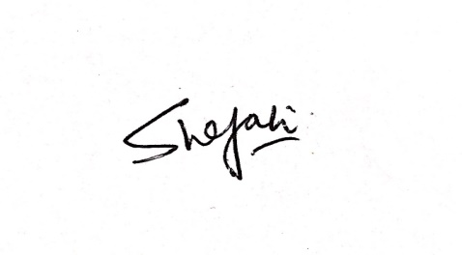
FOR ANY ADDITIONAL INFORMATION OR DISCUSSION, STUDENTS MAY FEEL FREE TO CONTACT THE UNDERSIGNED.
DR. SHEFALI KAPOOR ASSISTANT PROFESSOR DEPARTMENT OF MATHEMATICS SRCC

